Slide 1

Significant Protocol Changes at ACME LOONIVERSITY
Anne Clancy, Jayson Egeler, Jean Kundert, Mary Travis
May 2017 iCare TTI

Slide 2

Welcome new Principal Investigators!

Slide 3
Goal
Understand ACME Looniversity policy for review and approval of significant amendments to ensure compliance
Define a significant amendment based on our institutional policy
Differentiate between examples of significant or minor protocol amendments
Predict the proper method of IACUC review for significant amendments
Objectives

Slide 4
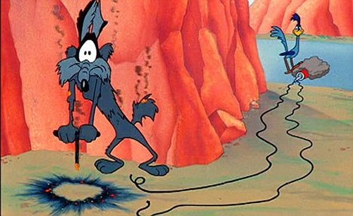
Definition of Significant Change
Changes that have, or have the potential to have, negative impact on animal welfare. In addition some activities that may not have a direct impact on animal welfare are also considered to be significant.
OLAW Guidance (NOT-OD-14-126)

Slide 5
ACME LOONIVERSITY IACUC AMENDMENT POLICY
Criteria & Process for Amendments to IACUC Protocols
All amendments to IACUC Protocols must be reviewed by the IACUC before implementation.
Amendments are reviewed through one of the following methods:
Administrative Review
Designated Member Review (DMR)
Full Committee Review (FCR)
Veterinary Verification and Consultation (VVC)

Slide 6
ACME LOONIVERSITY IACUC AMENDMENT POLICY
ADMINISTRATIVE REVIEW (MINOR):
Personnel changes (excluding PI)
Reduction in the proposed number of animals
Refinement in techniques to be less invasive
One-time addition of up to 10% of the total animal numbers requested (mice and rats only)
Change in strain of mouse
Minor Changes- no impact on animal welfare that can be reviewed by the IACUC office staff only.

Slide 7
ACME LOONIVERSITY IACUC AMENDMENT POLICY
DESIGNATED MEMBER REVIEW- DMR (SIGNIFICANT):
Addition of >10% of the total animal numbers
requested (mice and rats)
Addition of animal numbers for USDA covered species
Addition of noninvasive procedure
Changes in husbandry (e.g., addition of a new diet)
Change in PI
Significant changes that can be reviewed by appropriately qualified IACUC members appointed to conduct the review.

Slide 8
ACME LOONIVERSITY IACUC AMENDMENT POLICY
FULL COMMITTEE REVIEW-FCR (SIGNIFICANT):
Changes in the objectives of the study
A proposal to switch from a non-survival to survival surgery
Increases in the degree of invasiveness of a procedure or discomfort to an animal
Change in species
Addition of a hazardous material that requires special
handling of animals or bedding
Withholding analgesia
Significant changes reviewed by a convened quorum
of the IACUC.

Slide 9
ACME LOONIVERSITY IACUC AMENDMENT POLICY
VETERINARY VERIFICATION AND
CONSULTATION-VVC (SIGNIFICANT)**
Change in anesthesia, analgesia, sedation, or
experimental substances
Change in euthanasia to an AVMA-approved method
Change in duration, frequency, type, or number of procedures performed on an animal
Significant changes approved administratively with veterinary consultation per a new guidance from OLAW. The veterinarian acts as a subject matter expert to verify that changes requested meet the criteria in the IACUC policy. The veterinarian may
refer any requests to IACUC review at any time for any
reason.

Slide 10
Activity #1: Significant(S) vs. Minor(M) Polling
#1 Add undergraduate student to personnel section M
#2 Add 20 mice to a protocol that currently has 800 mice approved M
#3 Add an IP injection of ketamine/xylazine as anesthesia for survival surgery S
#4 Change “human” euthanasia to “humane” euthanasia in the euthanasia section M
of the protocol
#5 Add an additional experimental compound; no changes in procedure S
#6 Adding osmotic pump implant to an existing project to replace IP injection S

Slide 11
Activity #2: Significant Change Review Methods
Each group discuss the scenario on your handout
(5 minutes):
  Identify the method of review as FCR, DMR, or VVC
  Justify your answer
  Report out (5 minutes).

Slide 12

#1 Significant Change Scenario
Dr. Porky Pig has an IACUC approved project involving mice where 200ul of blood is collected monthly via saphenous vein collection. He recently hired the Tasmanian Devil as a new lab technician that is proficient in multiple bleeding techniques and has completed ACME IACUC required training. Dr. Pig requests that blood collection be increased to 200ul every 2 weeks using the mandibular vein collection method.

Slide 13

#2 Significant Change Scenario
Dr. Wile E. Coyote is working with mice in a previously approved mouse adapted flu study. Currently, he is approved for CO2 euthanasia. This has been shown to negatively impact lung tissue samples. Dr. Coyote is requesting to change the euthanasia method to an IP injection of sodium pentobarbital.

Slide 14
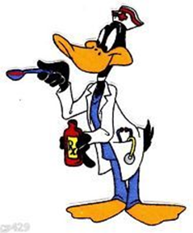
#3 Significant Change Scenario
Dr. Yosemite Sam has taken a new position at Flanders University in Adelaide Australia. His Post Doc Dr. Daffy Duck has remained at ACME to complete the current IACUC approved project. Dr. Sam requests the PI be changed to Dr. Duck.

Slide 15

#4 Significant Change Scenario
Dr. Bugs Bunny has completed a pilot study using 100 mice. His preliminary data is very promising and supports moving forward with this infectious disease model. Analgesics have been shown to interfere with the clinical course of the disease and cannot be used. He requests an additional 2100 mice.

Slide 16
Goal
Understand ACME Looniversity policy for review and approval of significant amendments to ensure compliance
Objectives
Define a significant amendment based on our institutional policy
Differentiate between examples of significant or minor protocol amendments
Predict the proper method of IACUC review for significant amendments

Slide 17
Summative Assessments 1/3
Select the appropriate definition(s) of a significant protocol amendment:
  a change that directly impacts the animals and the research
  a change to the protocol that substantially alters or affects the overall study objectives/rationale
  a change that impacts personnel safety
  a change in funding source

Slide 18
Summative Assessments 2/3
Classify the activities on this list as (S) Significant or (M) Minor protocol changes:
______changes from non-survival to survival procedures
______changes in study objectives
______changes in species
______add/change in Research Technician
______changes in Principal Investigator
______changes in housing location
______changes that impact personnel safety

Slide 19
Summative Assessments 3/3
Match the review method to the significant change per Institutional policy and justify your answer:
A=FCR _______ Change in analgesic
B=DMR _______ Adding a Category E procedure
C=VVC _______ Change in PI

Slide 20


